Slide 1
JOINT EXAMINATIONS
DR DILSHAN MUNIDASA

Slide 2
Must not forget….
There are two sides
Look – from front, sides ,behind
Feel – Look at the patients face
Move - Active, Passive, Abnormal

Slide 3
What to look for ?
Deformities
Inflammation/ infection - Warmth
Movement ranges
Strength of movements
Tender points
Abnormal sounds – crepitus
Fluid in the joints
Ligament stability

Slide 4
Start examinatiom
Explain examination:
“Today I need to examine your hip joints, this will involve looking,
feeling and moving the joints.”
Check understanding and gain consent:
“Does everything I’ve said make sense?
Are you happy for me to examine your hips?”
Ask if the patient has had a joint replacements
Expose patient appropriately
Position patient accordingly
Ask if the patient currently has any pain

Slide 5
Hip Joint

Slide 6
Look
Look around bed for any aids or adaptations – walking stick / wheelchair
Inspect patient from all angles
Front – scars / pelvic tilt /quadriceps wasting / foot deformity
Side – assess lumbar lordosis – normal / hyperlordosis
Behind – scoliosis / gluteal wasting / pelvic tilt

Slide 7
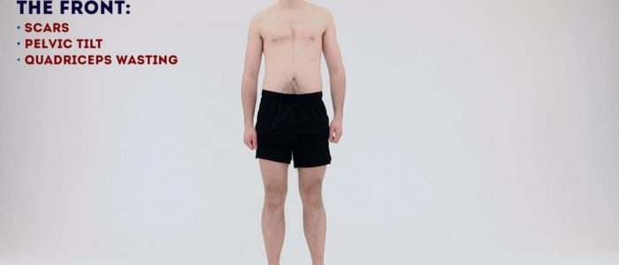

Slide 8
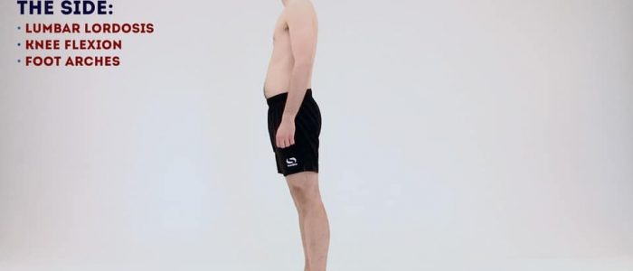

Slide 9
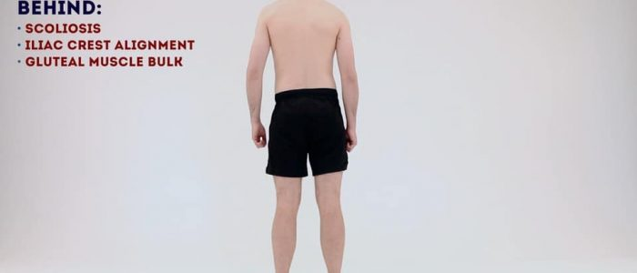

Slide 10
Gait
Observe the patient’s gait from multiple angles
Assess speed /smoothness /turning
Note any evidence of antalgic gait or Trendelenburg gait
Assess the patient’s footwear – unequal sole wearing – abnormal gait

Slide 11
Feel
Ask patient to lay down on the examination couch
Palpate the tissues overlying the hip joint for tenderness/warmth – inflammation/infection
Palpate the greater trochanter – tenderness (often indicative of greater trochanteric bursitis)
Assess leg length
Measure apparent leg length – umbilicus to the tip of the medial malleolus
Measure true leg length – anterior superior iliac spine to the tip of the medial malleolus

Slide 12
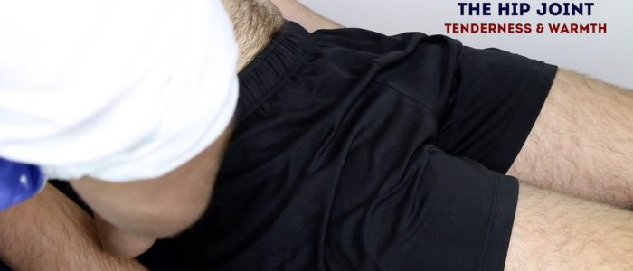
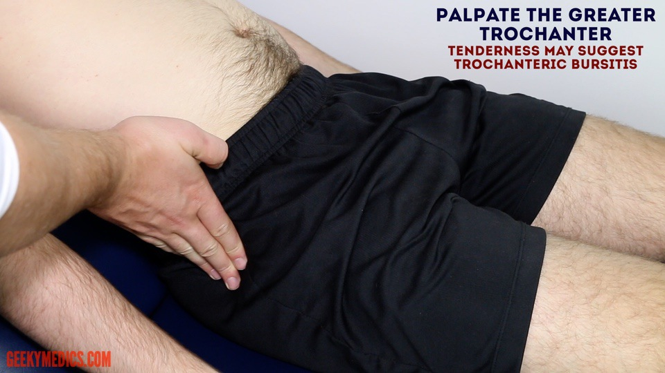
Tenderness and warmth

Slide 13
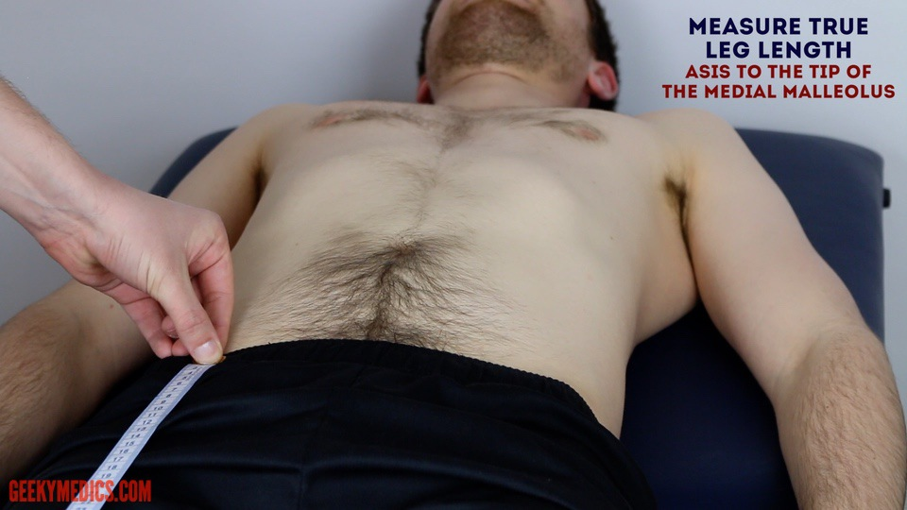
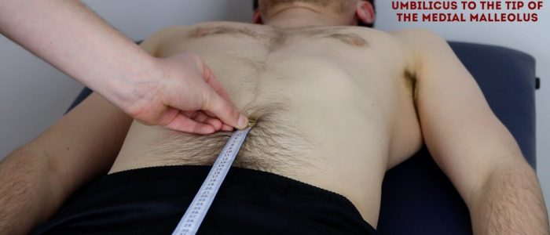
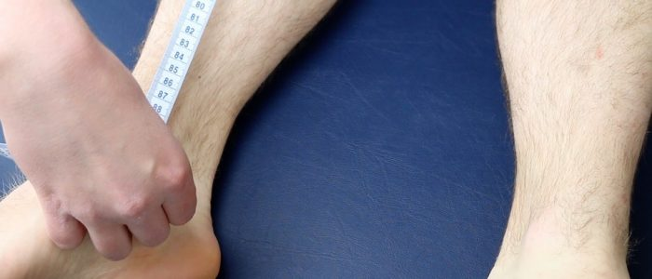

Slide 14
Hip Examination
Active movements
Place your hand under the lumbar spine to detect masking of hip movement by the pelvis / lumbar spine.
Flexion – “bring your knee towards your chest” – normal ROM is 120°
Passive movements
Flexion – assess the degree of flexion in each hip individually – normal ROM is 120°
Internal rotation:
This can be assessed with the hip and knee joint flexed at 90°
Rotate the foot laterally
Normal ROM 40°
External rotation:
This can be assessed with the hip and knee joint flexed at 90°
Rotate the foot medially
Normal ROM 45°
ABduction – whilst stabilising the contralateral iliac crest, use your other hand to abduct the hip until you feel the pelvis begin to tilt – normal ROM is 45°
ADduction – whilst stabilising the contralateral iliac crest, use your other hand to adduct the patient’s leg across the midline as far as possible – normal ROM is 30°

Slide 15
Internal rotation:
This can be assessed with the hip and knee joint flexed at 90°
Rotate the foot laterally
Normal ROM 40°
External rotation:
This can be assessed with the hip and knee joint flexed at 90°
Rotate the foot medially
Normal ROM 45°

Slide 16
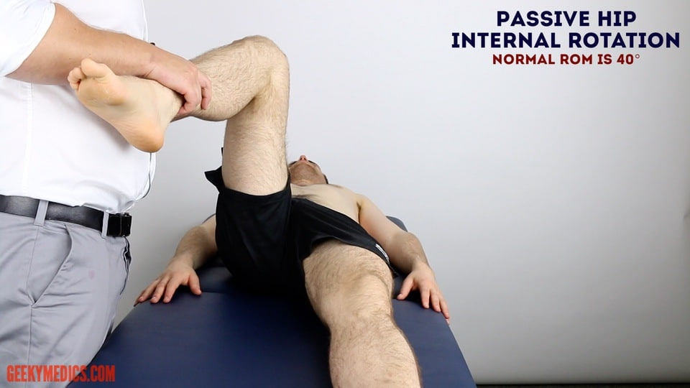
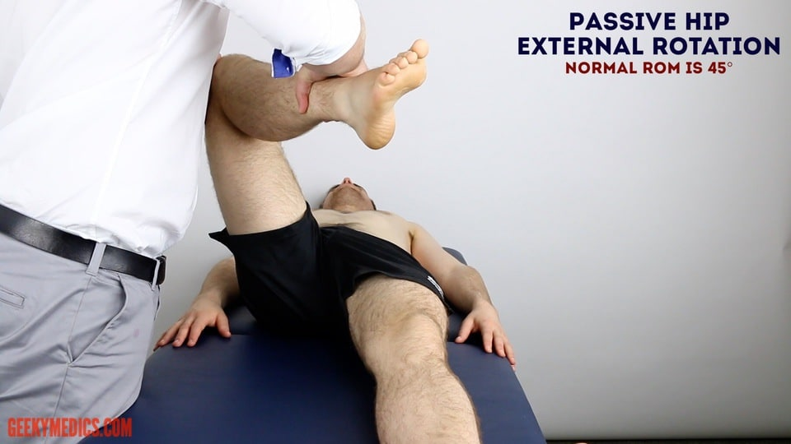

Slide 17
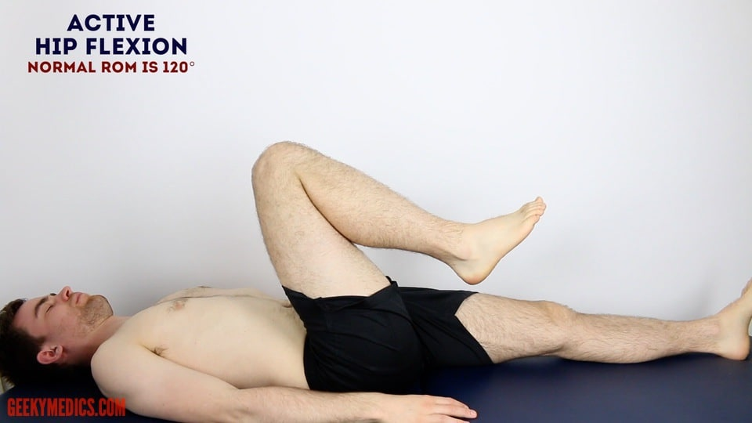
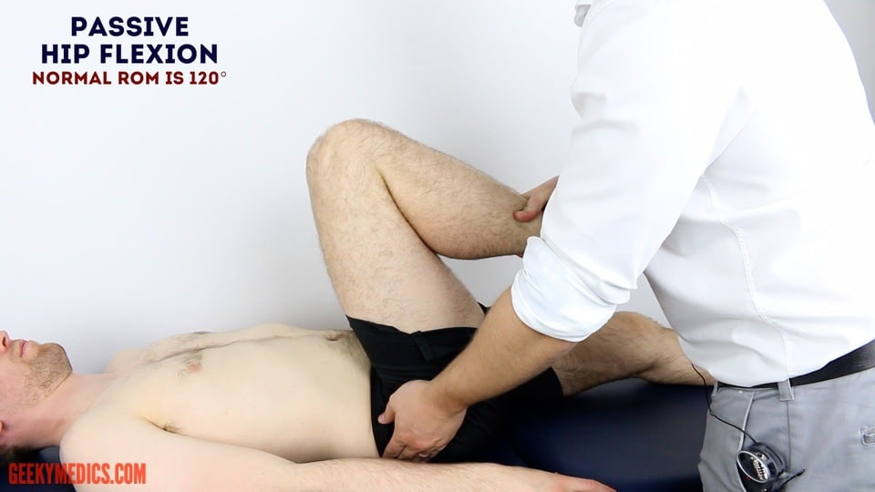
Flexion – assess the degree of flexion in each hip individually – normal ROM is 120°

Slide 18
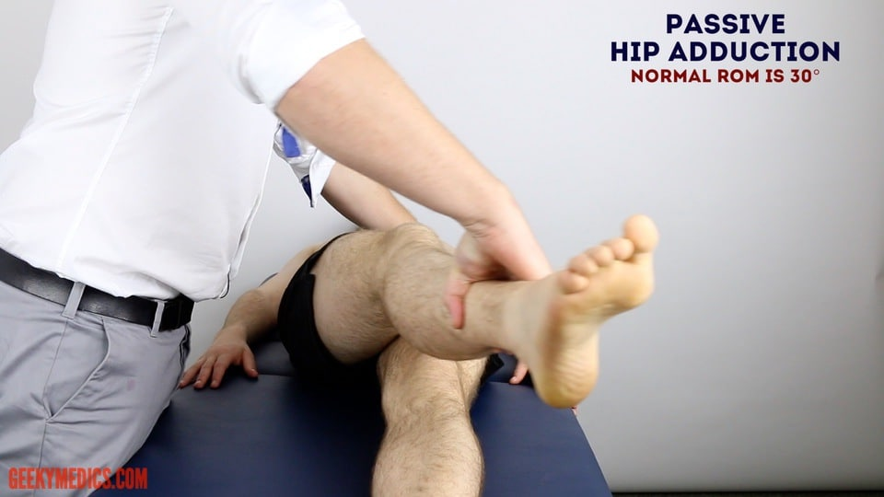
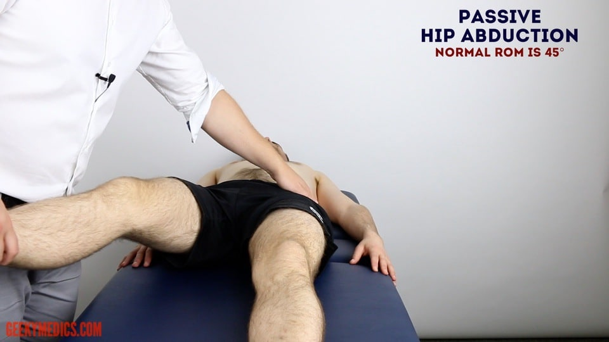
ABduction – whilst stabilising the contralateral iliac crest, use your other hand to abduct the hip until you feel the pelvis begin to tilt – normal ROM is 45°
ADduction – whilst stabilising the contralateral iliac crest, use your other hand to adduct the patient’s leg across the midline as far as possible – normal ROM is 30°

Slide 19
Special tests - Thomas’s test
Place a hand under the patient’s spine.
Passively flex the unaffected leg (hips/knees) as far as you are able to.
Your hand should detect that the lumbar lordosis is now flattened.
With the unaffected leg flexed, the contralateral leg should be flat on the bed
Repeat the test to assess the contralateral hip joint.
The test is positive (abnormal) if the affected thigh raises off the bed, indicating a loss of extension in the hip. This would suggest a fixed flexion deformity in the affected hip.
DO NOT PERFORM ON PATIENTS WITH HIP REPLACEMENTS – can cause dislocation!

Slide 20
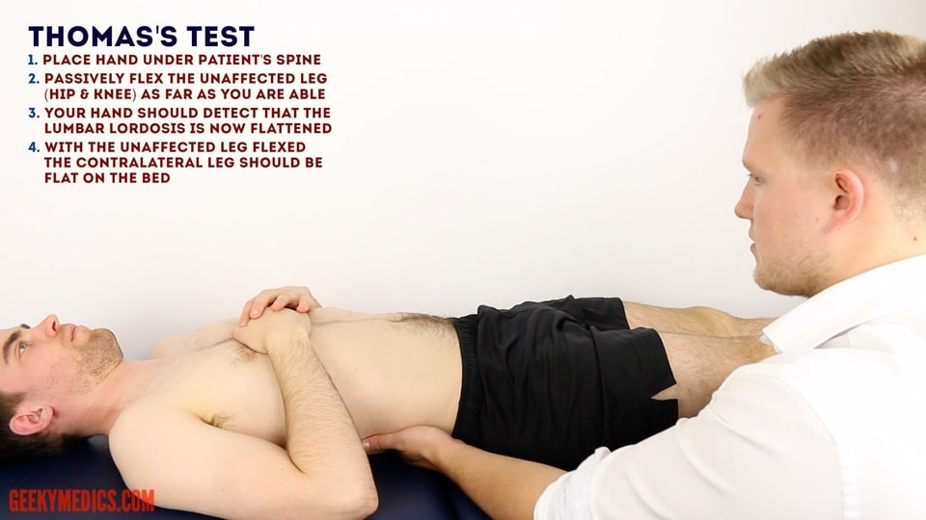
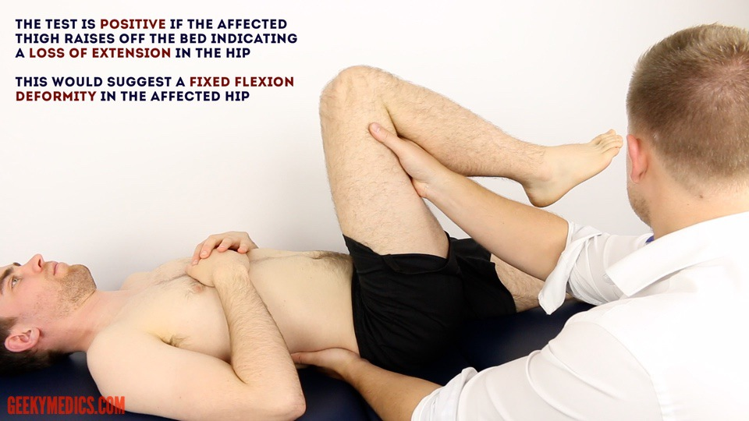

Slide 21
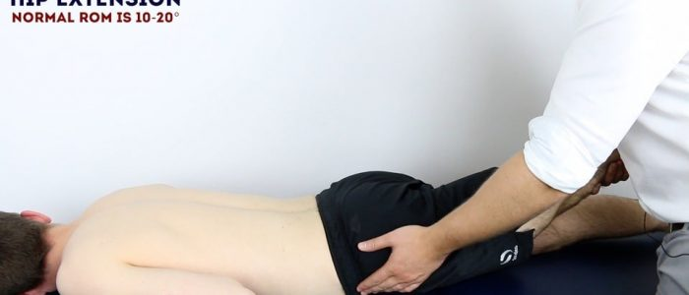

Slide 22
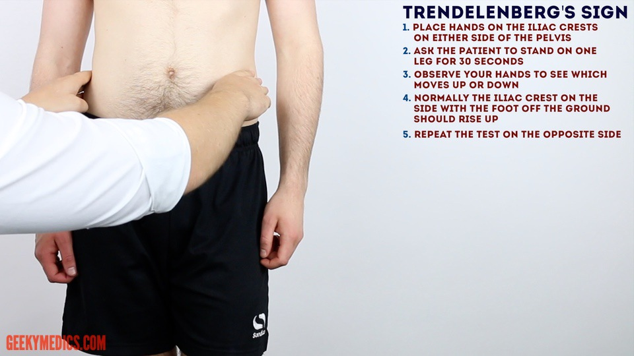

Slide 23
Knee Joint

Slide 24
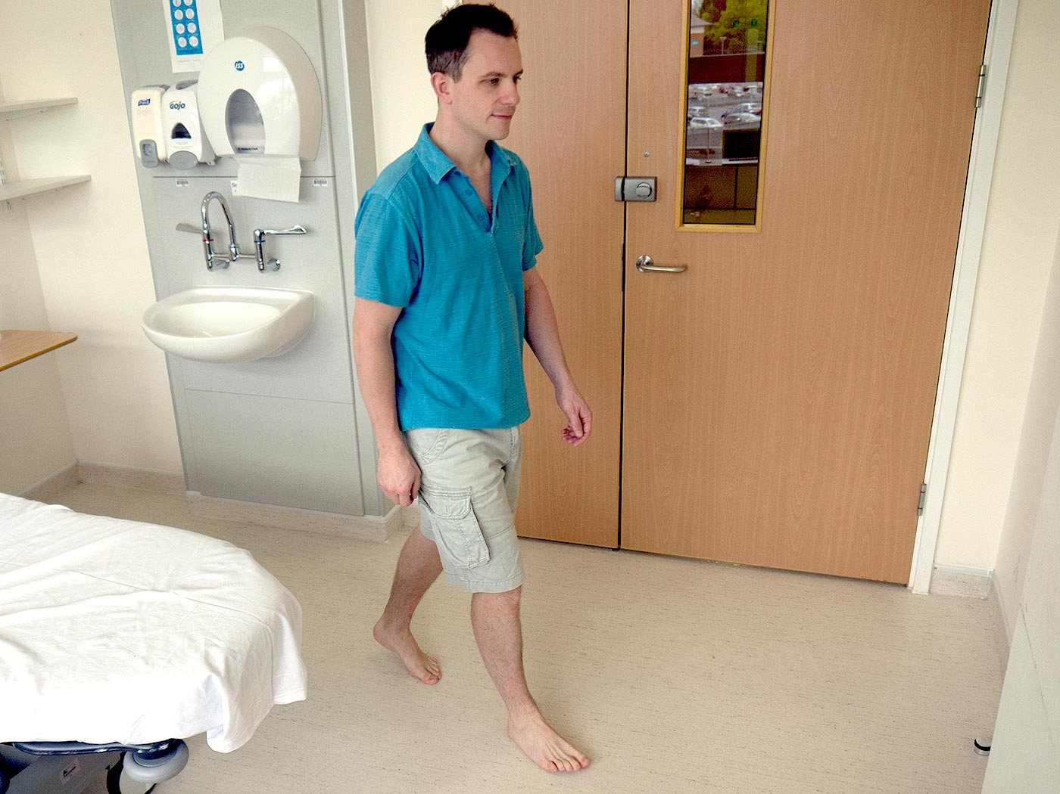
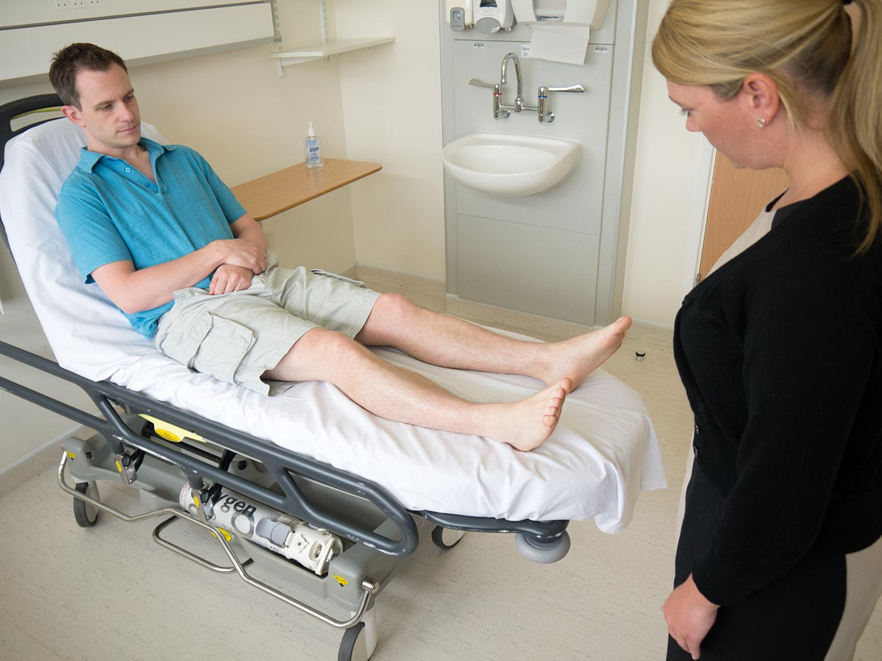

Slide 25
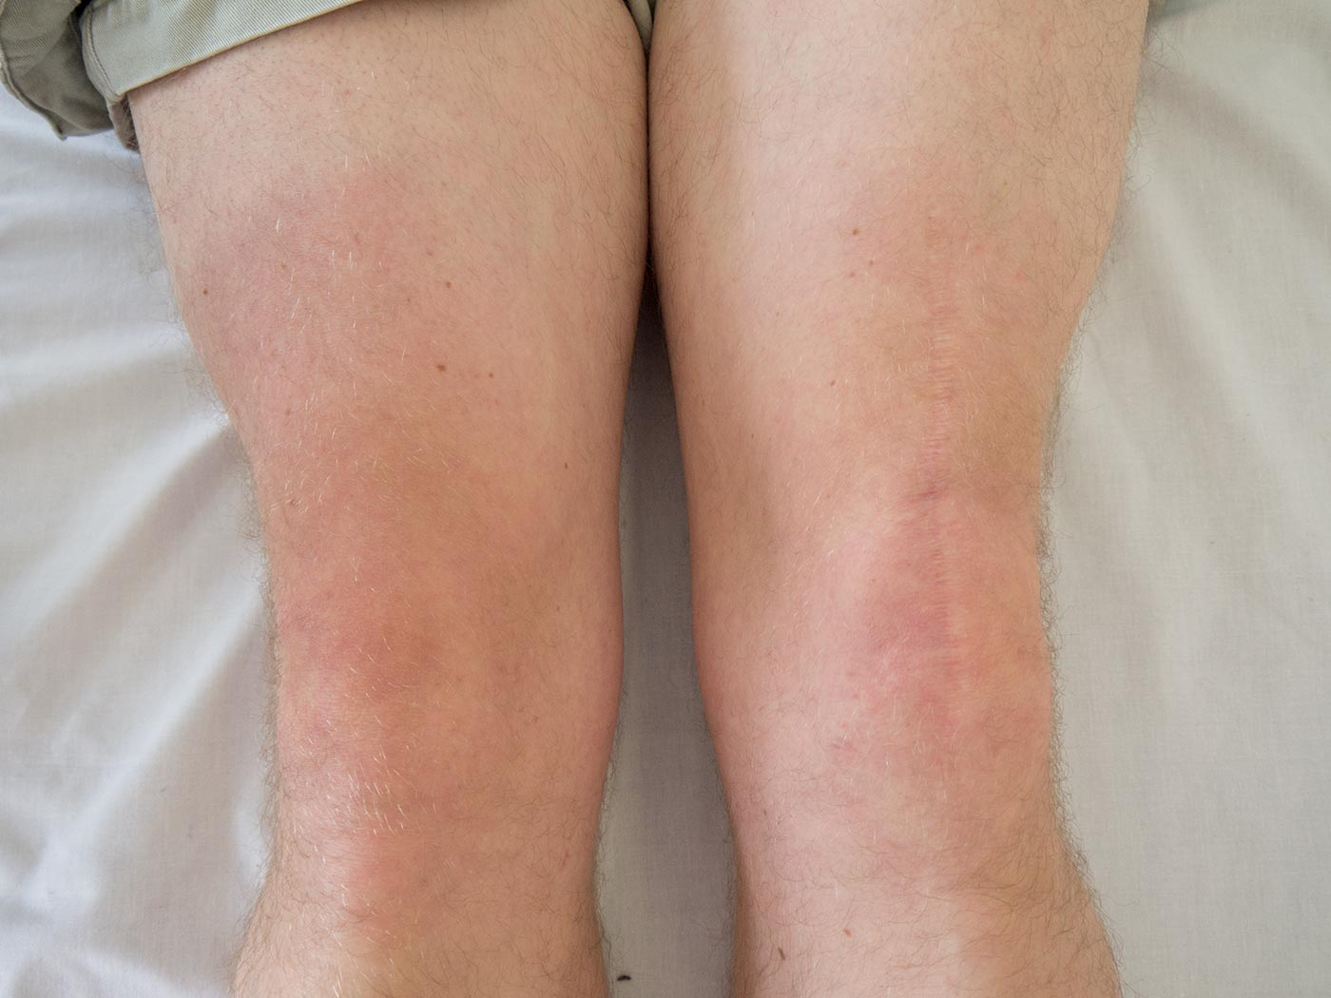
Inspection

Slide 26
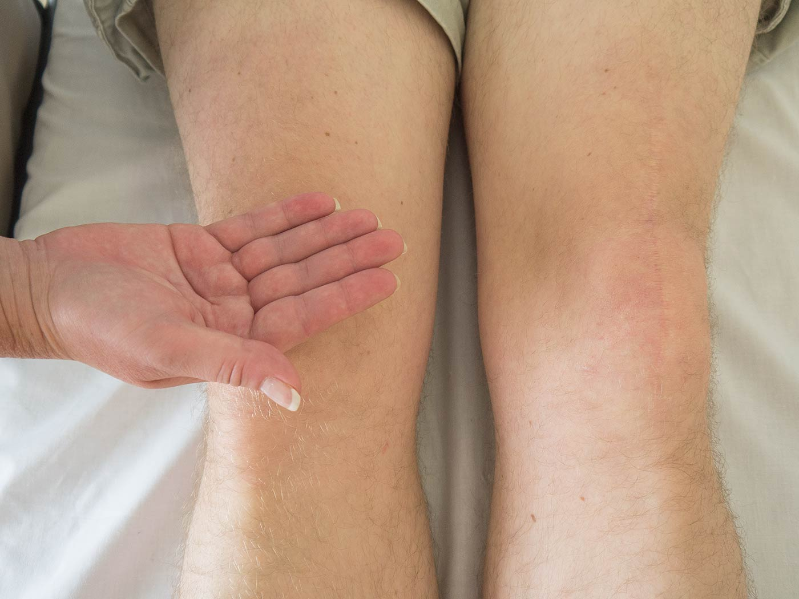
Palpation

Slide 27
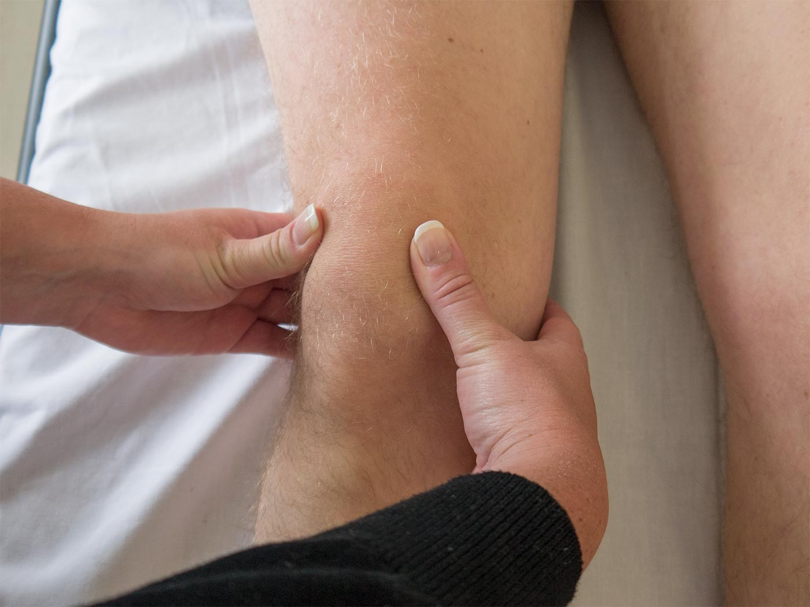
Palpate the border of the patella for any tenderness, behind the knee for any swellings, along all of the joint lines for tenderness and at the point of insertion of the patellar tendon.
Finally, tap the patella to see if there is any effusion deep to the patella.
Palpation

Slide 28
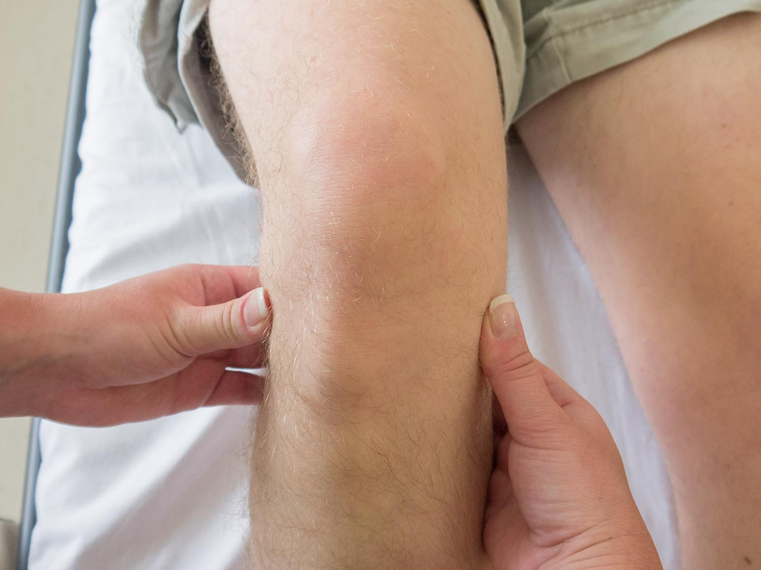
Joint lines

Slide 29
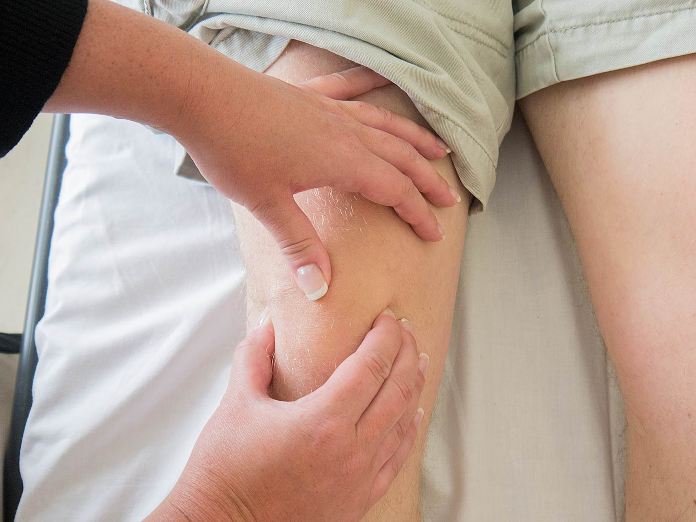
Patellar position

Slide 30
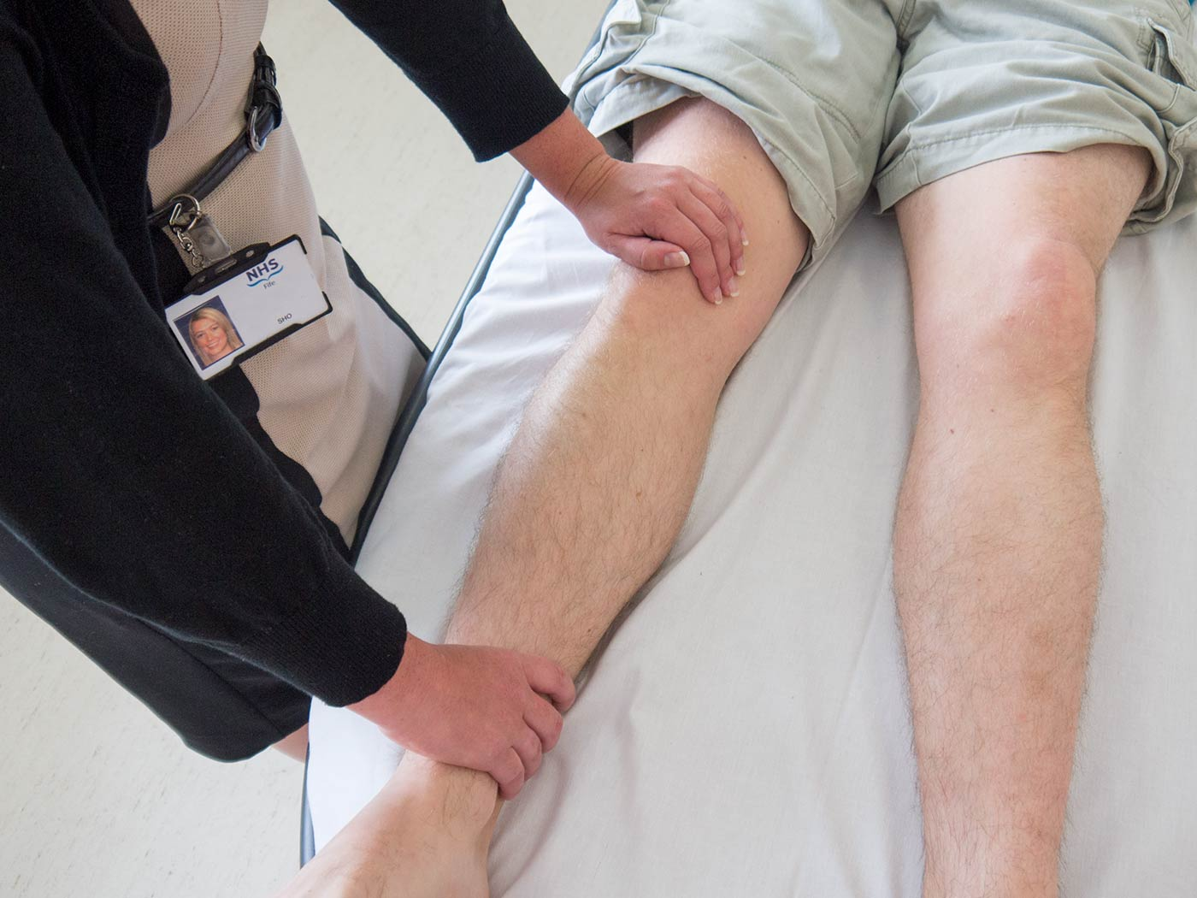
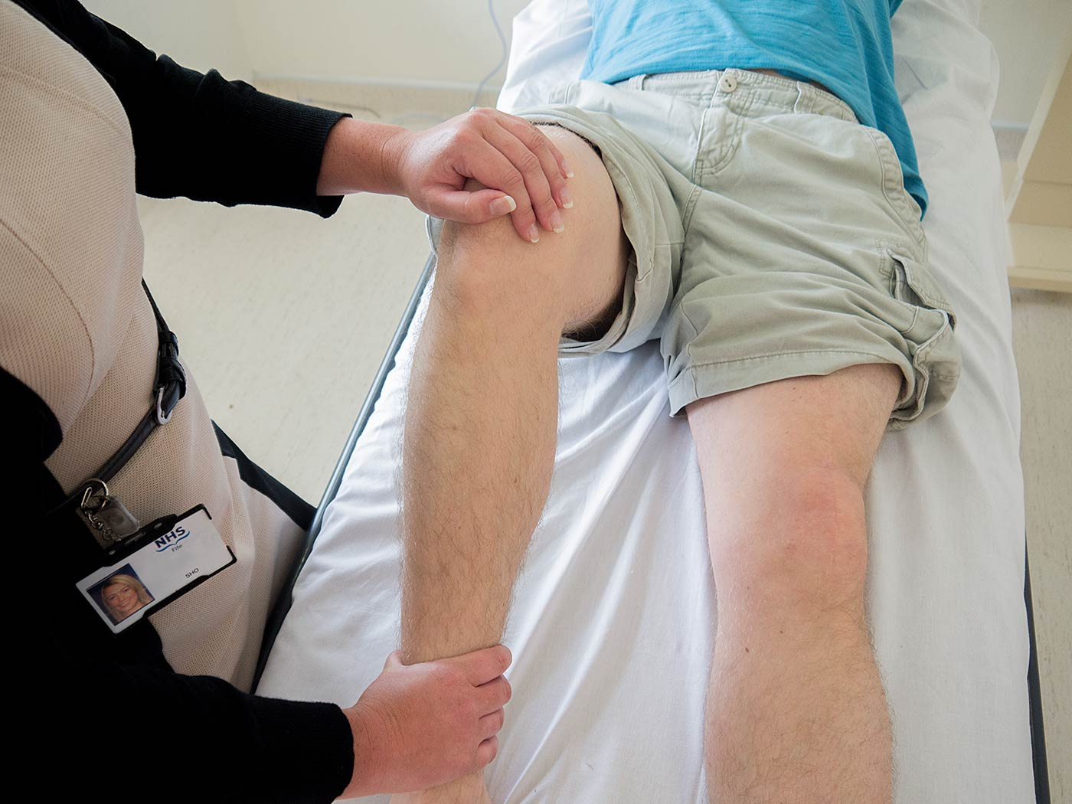
The main movements which should be examined both actively and passively are:
Flexion
Extension
A full range of movements should be demonstrated and you should feel for any crepitus.

Slide 31
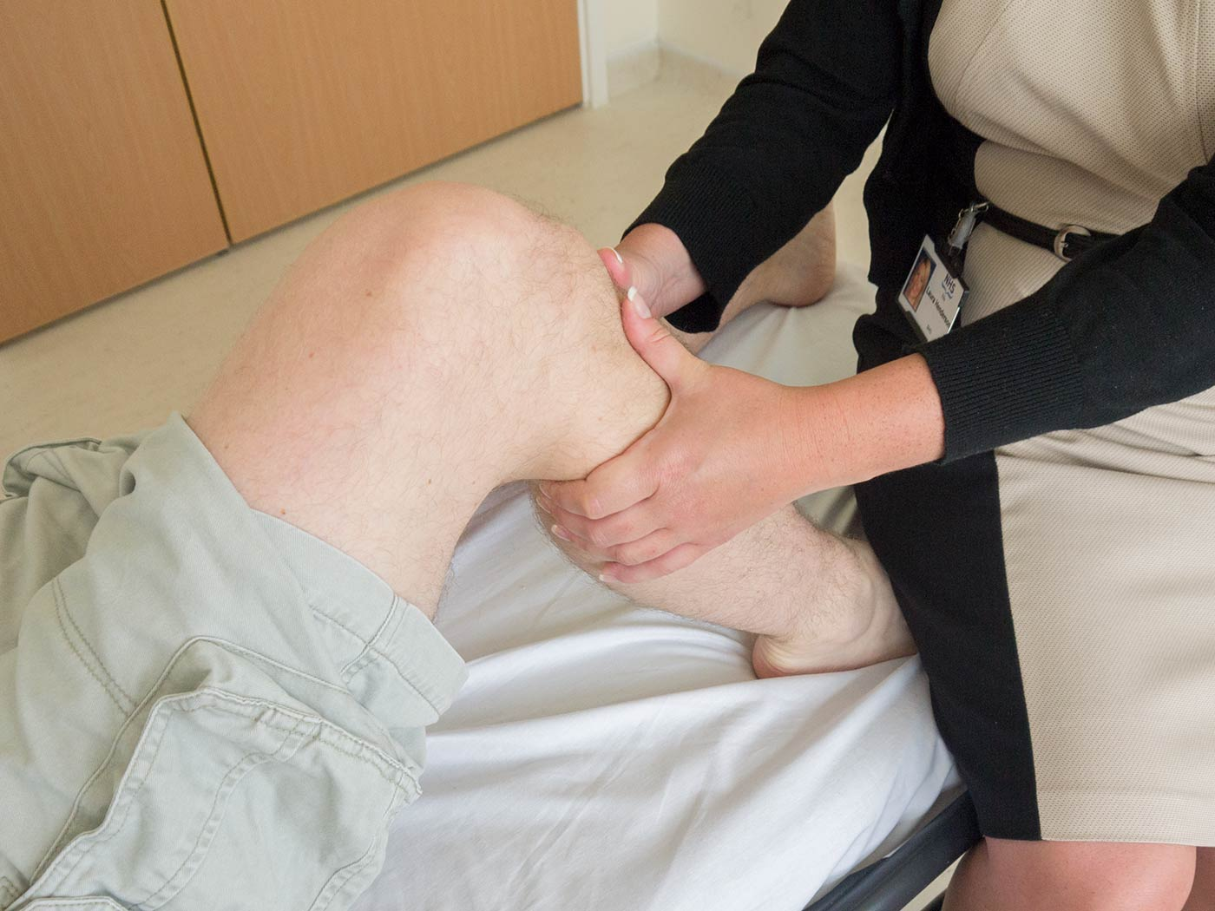
Anterior drawer test:
Flex the knee to 90 degrees and sit on the patient’s foot. Pull forward on the tibia just distal to the knee. There should be no movement. If there is movement, it suggests anterior cruciate ligament damage.
Another test for ACL damage is Lachman’s test.

Slide 32
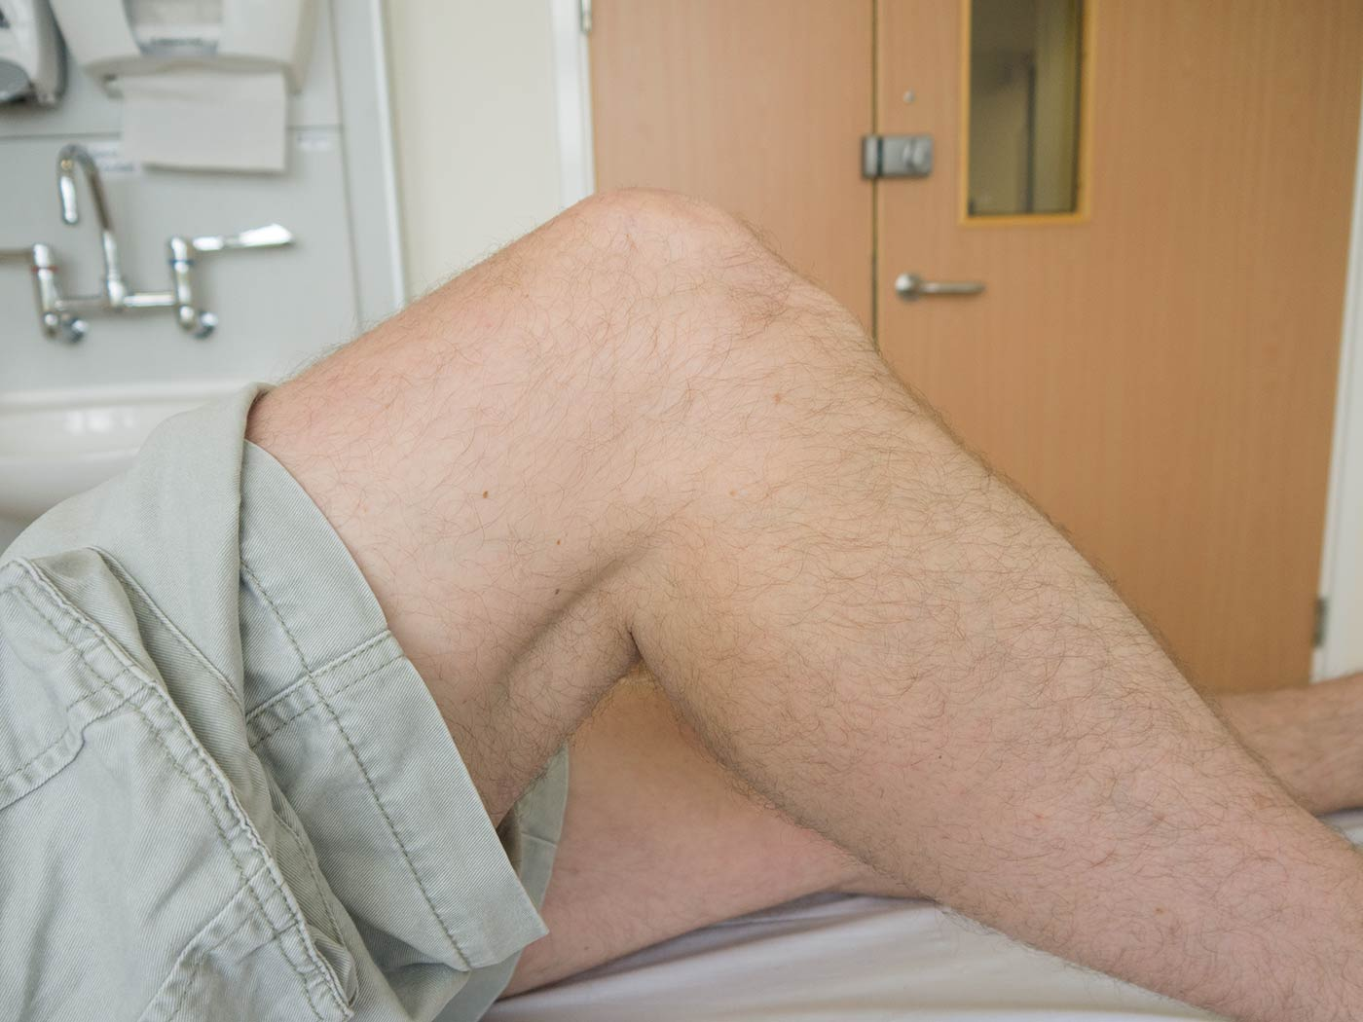
Posterior drawer test
With the knee in the same position, observe from the side for any posterior lag of the joint, this suggests posterior cruciate ligament damage.

Slide 33
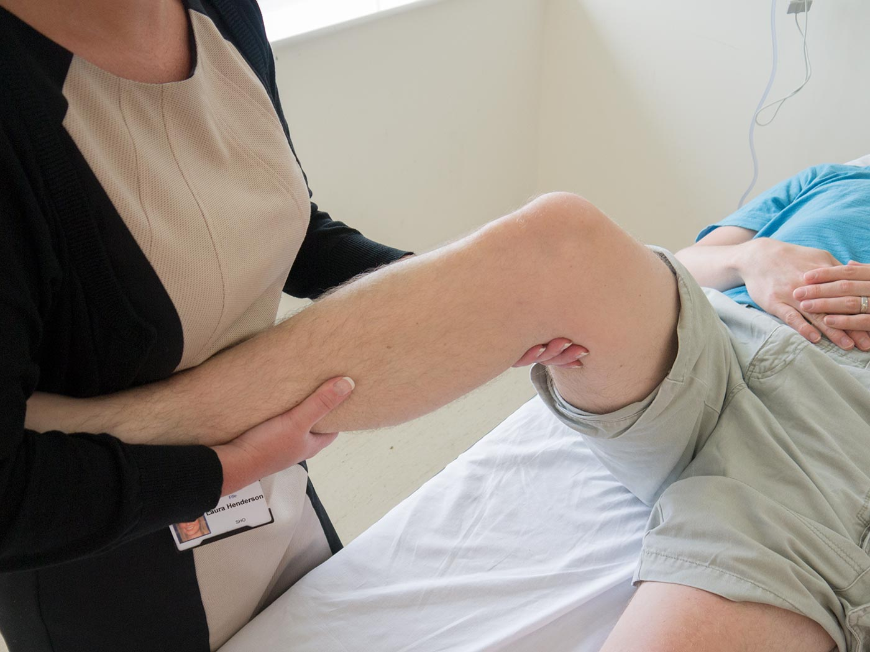
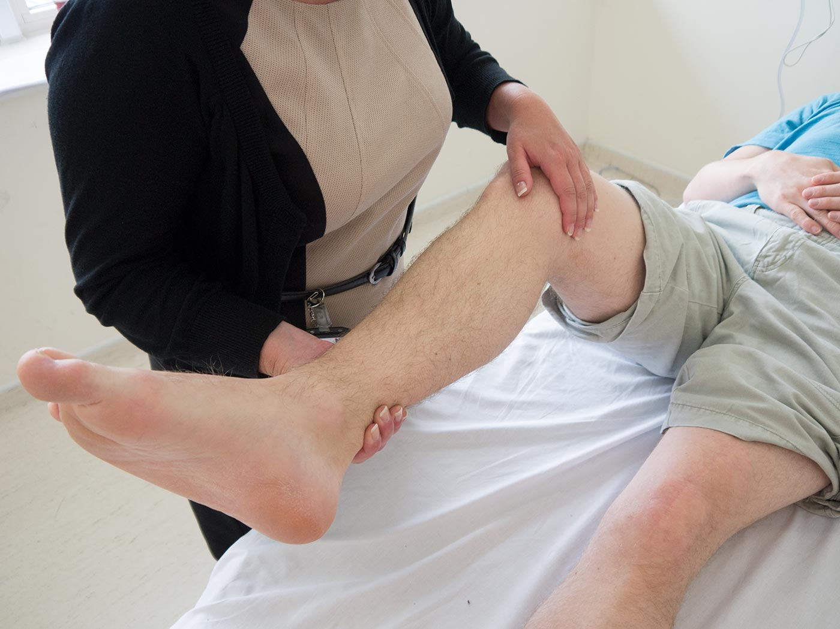
Lateral stress test at 15 degrees flrxion

Slide 34
Shoulder

Slide 35
Prepare
Check understanding and gain consent:
“Does everything I’ve said make sense? Are you happy for me to examine your shoulders?”
Expose patient’s upper body appropriately
Position the patient standing
Ask if the patient currently has any pain

Slide 36
Inspect the patient
Anterior
Scars – previous surgery / trauma
Asymmetry of the shoulder girdle:
Scoliosis
Arthritis
Trauma – clavicular fracture/humeral fracture/anterior dislocation of the humeral head
Swelling – inflammatory joint disease / effusion / anterior dislocation
Muscle wasting – deltoids – axillary nerve injury (traumatic/iatrogenic)

Slide 37
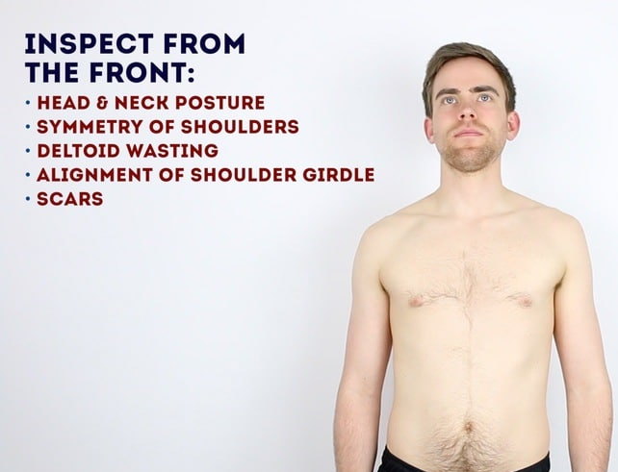
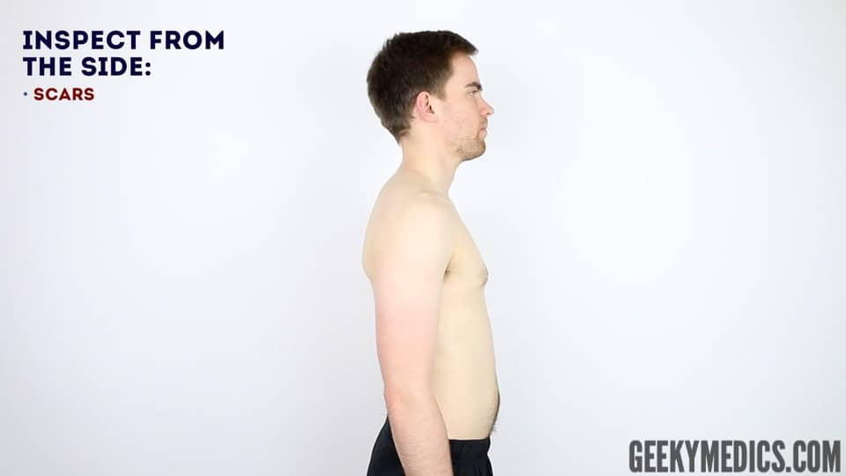

Slide 38
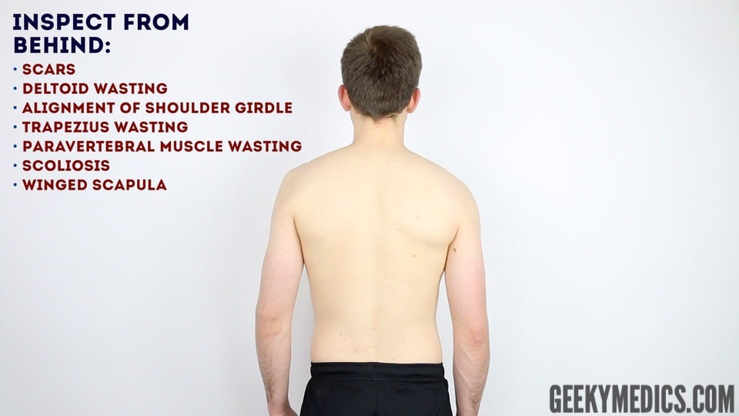

Slide 39
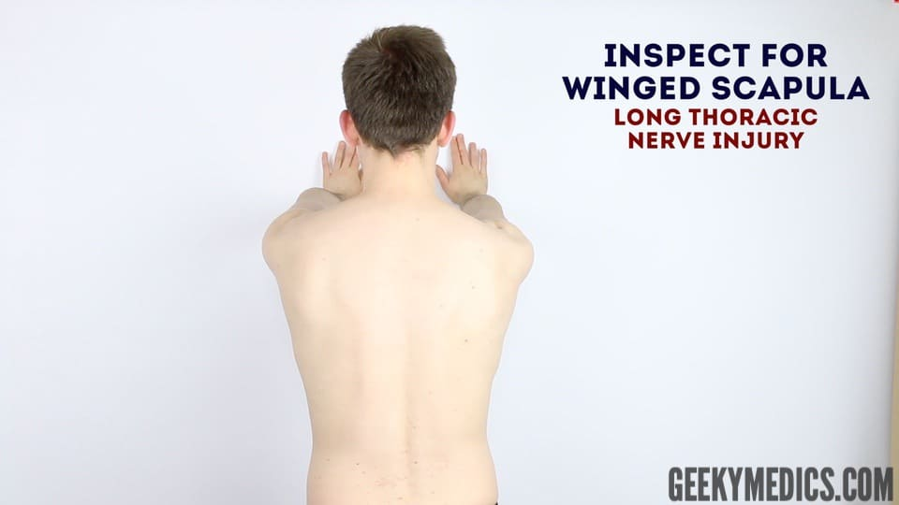

Slide 40
Feel
Assess temperature of shoulder joints – warmth may suggest inflammatory arthropathy/infection
Palpate the various components of the shoulder girdle (note any swelling / tenderness)
Sterno-clavicular joint
Clavicle
Acromio-clavicular joint
Coracoid process – 2cm inferior and medial to the clavicular tip
Head of humerus
Greater tuberosity of humerus
Spine of scapula

Slide 41
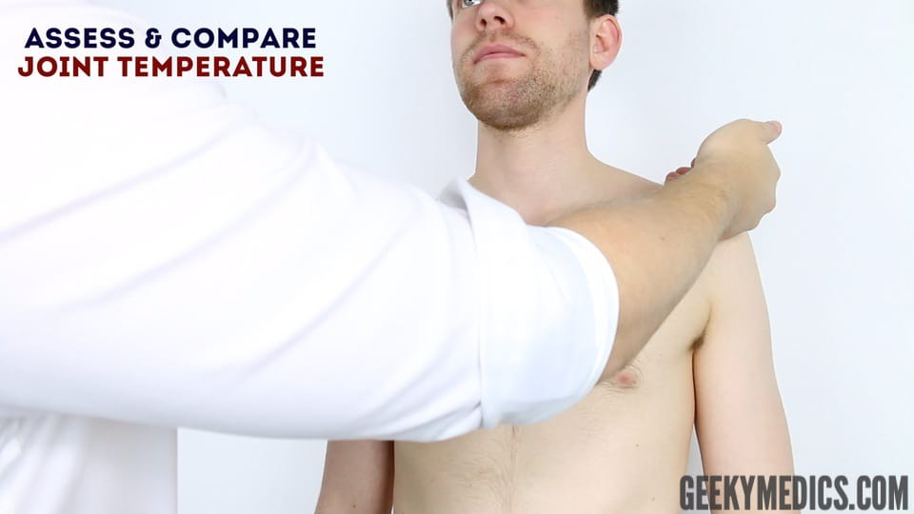

Slide 42
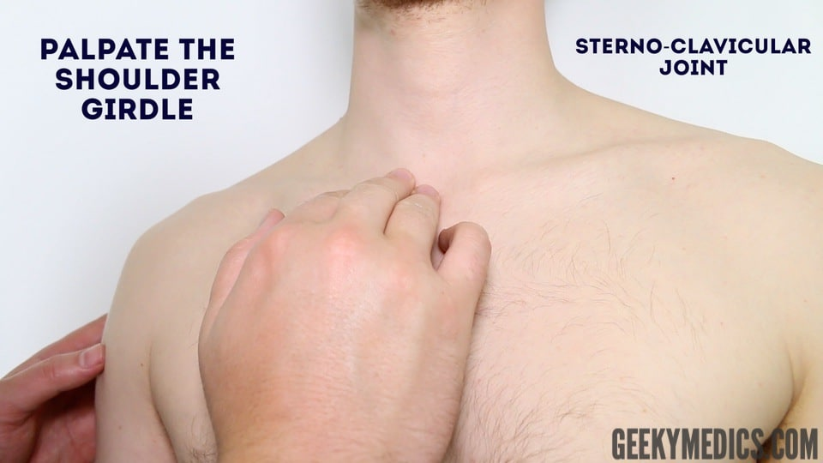

Slide 43
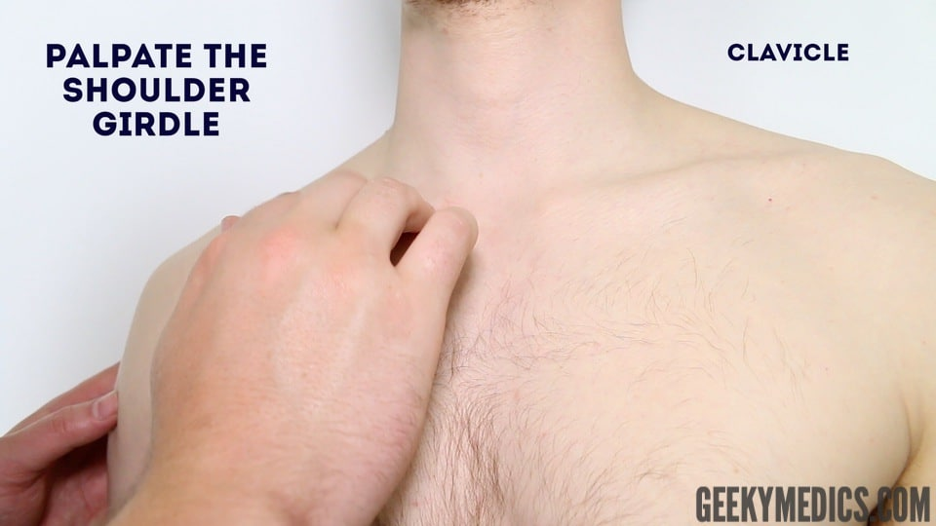

Slide 44
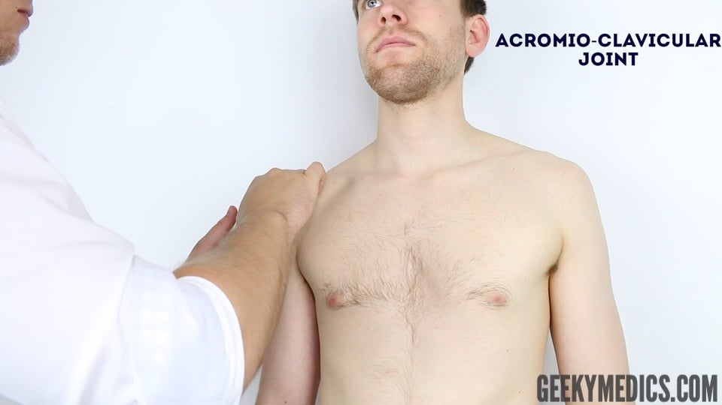

Slide 45
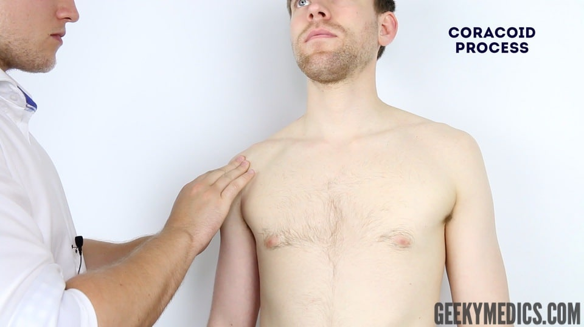

Slide 46
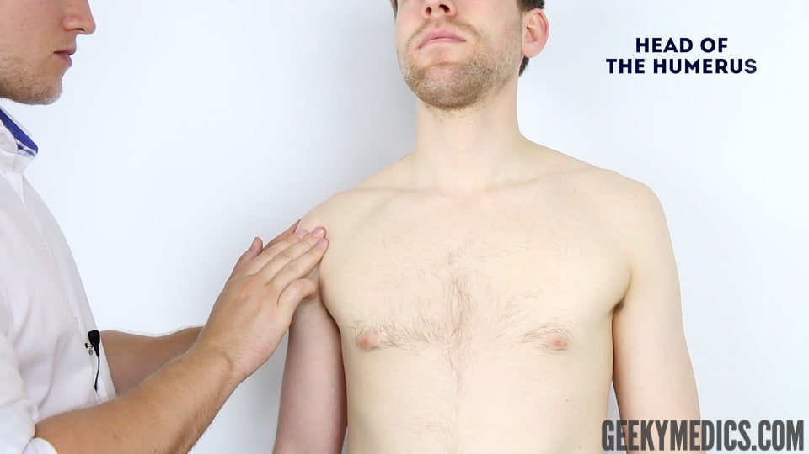

Slide 47
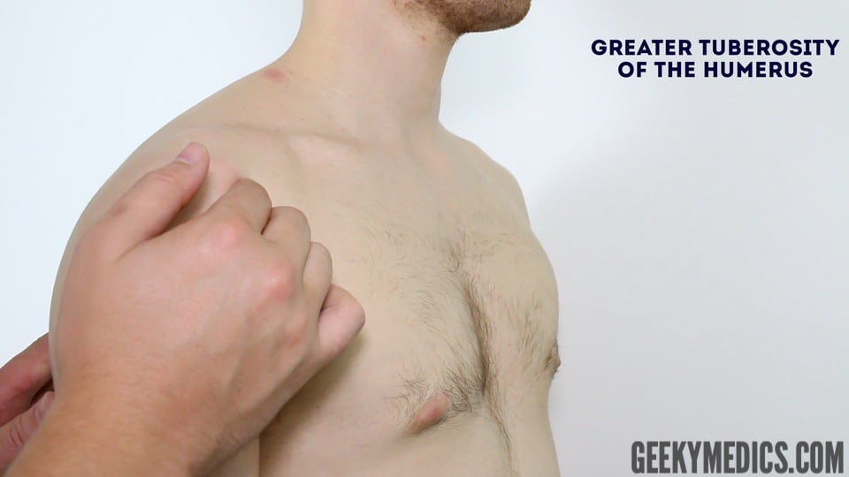

Slide 48
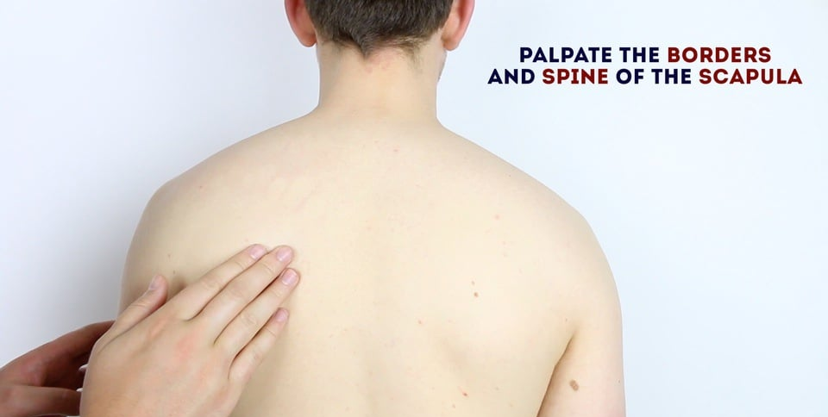

Slide 49
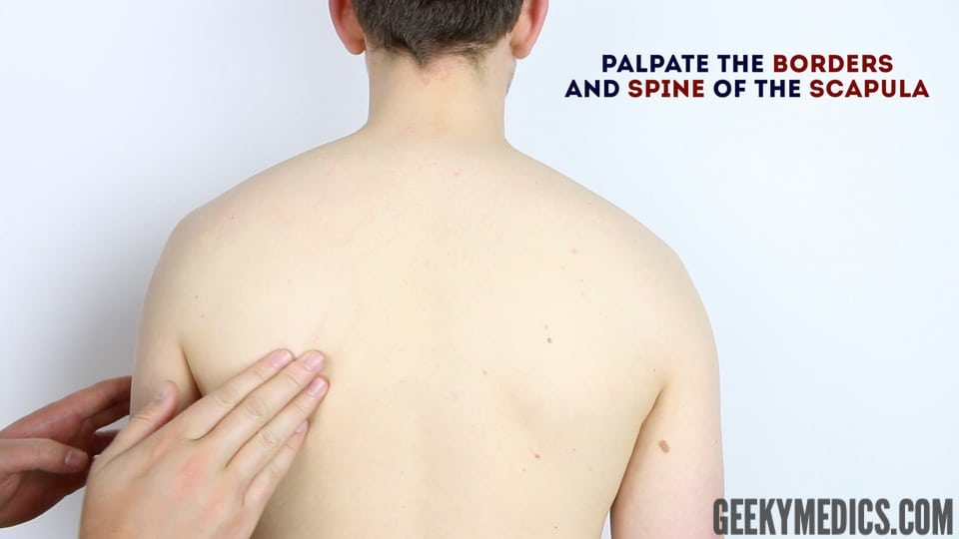

Slide 50
Move
Active movement
Ask the patient to perform each of the following movements.
Compound movements (screening)
Compound movements are often used as a rapid screening tool for shoulder joint pathology as they test a number of the rotator cuff muscles in one go. If the patient experiences pain or is unable to perform these movements you would then proceed to perform a more detailed examination of the shoulder joint as shown in the “full shoulder examination” section below.
Put your hands behind your head – external rotation and abduction
Put your hands as far up your back as you can – internal rotation

Slide 51
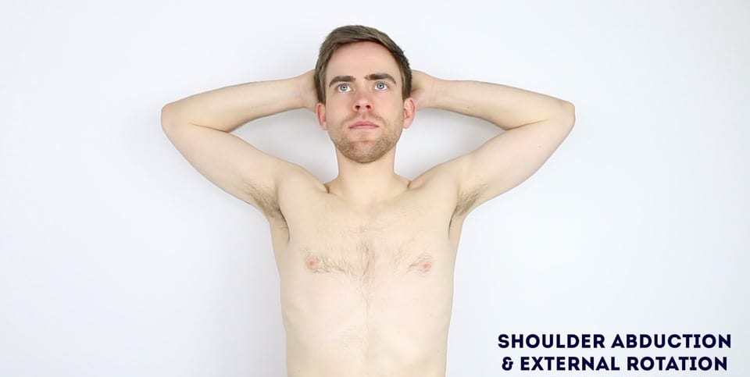
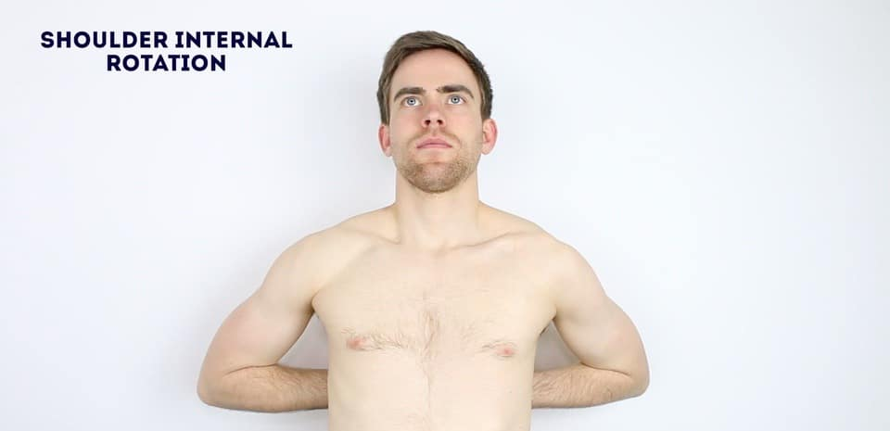
Compound movements

Slide 52
Full shoulder examination
Test active movements first by asking the patient to move their arm themselves.
Flexion – ask the patient to raise their arms forwards until they point upwards (Normal = 150°- 180°)
Extension – ask the patient to keep their arms straight and extend them behind them – (Normal = 40°)
ABduction – ask the patient to lift their arms away from their sides as far as possible – (Normal up to 180°)
ADduction – ask the patient to bring their arms across their trunk to the opposite sides – (Normal = 30°- 40°)
External rotation – ask patient to hold their elbows to their body flexed at 90° and then move their forearms outwards in an arc-like motion – (Normal 80° – 90°)
Internal rotation – with the patient’s elbow flexed at 90° (arm by their side) ask them to place their hand behind their back and reach as far up the spine as they can manage – (Normal average = T4-T8)
Assess the movement of the scapula:

Slide 53
Assess the movement of the scapula:
Ask the patient to abduct their shoulder
Simultaneously palpate the inferior pole of the scapula
Assess the degree and smoothness of movement of the scapula
On average 50-70% of the first movement occurs at the glenohumeral joint
If the glenohumeral joints movement is reduced due to injury or inflammation then the majority of abduction will occur via increased scapula movement over the chest wall.

Slide 54
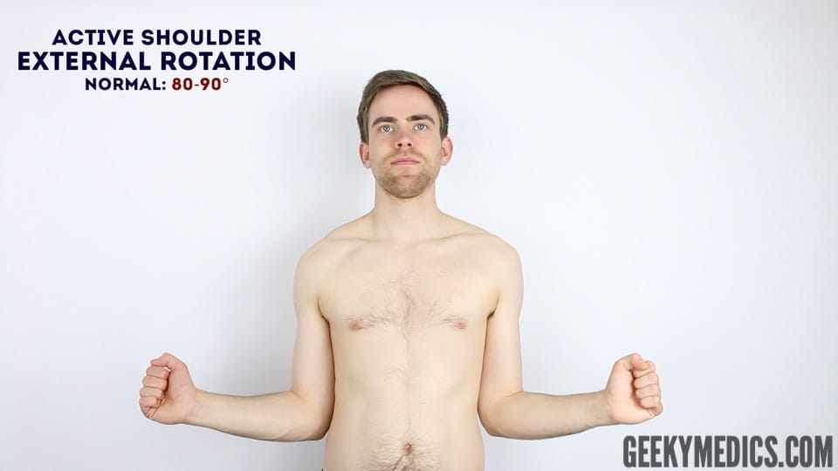
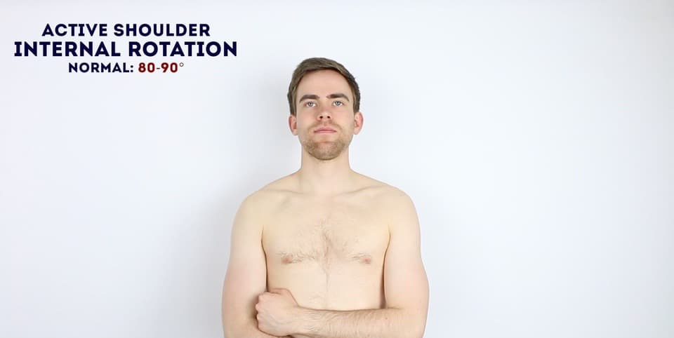

Slide 55
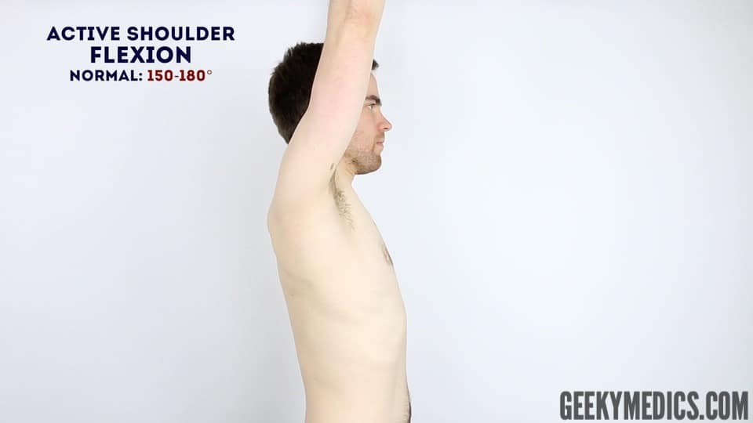
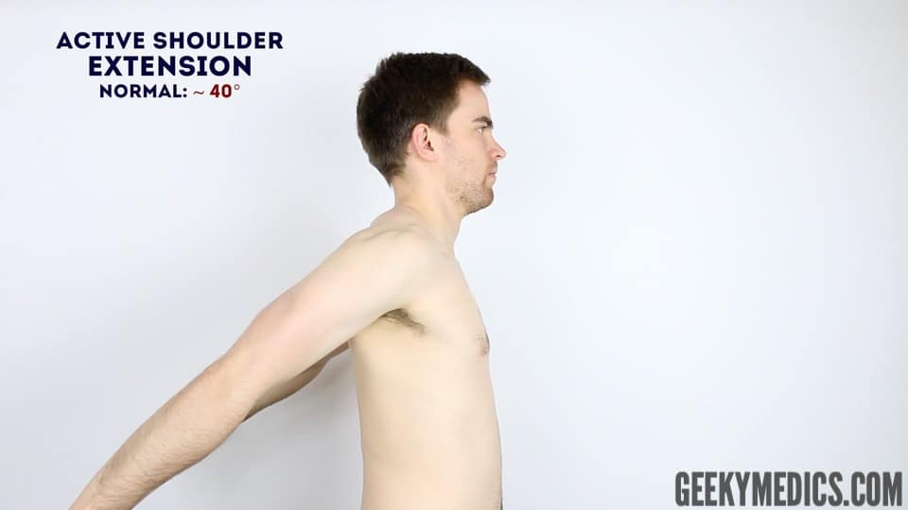



Slide 56
Passive movement
If abnormalities are noted on active movements (e.g. restricted range of movement), assess joint movements passively.
Ask the patient to fully relax and allow you to move their arm for them.
Warn them that should they experience any pain they should let you know immediately.
Repeat the above movements passively – feel for any crepitus during movement of the joint

Slide 57





Slide 58



Slide 59
Supraspinatus assessment – “Empty Can Test”
This clinical test assesses the function of supraspinatus.
Abduct the arm to 90° and angle the arm forward by ~30 ° (so that the shoulder is in the plane of the scapula).
Internally rotate the arm so that the thumb points down toward the floor. Now push down on the arm whilst the patient resists the pressure.
Repeat the assessment on the other arm.
This test assesses for weakness in the supraspinatus and/or impingement. Weakness may represent a tear in the supraspinatus or pain due to impingement.

Slide 60


Slide 61
The painful arc (impingement syndrome)
This clinical test assesses for impingement of supraspinatus.
1. Passively abduct the patient’s arm to its maximum point of abduction.
2. Ask the patient to lower their arm slowly back to a neutral position.
Impingement/supraspinatus tendonitis typically causes pain between 60-120° of abduction, however this test is not specific as many other conditions can cause pain in this arc of motion and therefore it should not be used in isolation for diagnosis.

Slide 62



Slide 63
External rotation against resistance
This clinical test assesses the function of infraspinatus.
Position the patient’s arm with the elbow flexed at 90°and in slight abduction (the abduction tests whether the patient can keep the arm externally rotated against gravity).
Passively externally rotate the arm to its maximum.
Pain on resisted external rotation may suggest infraspinatus tendonitis.
If the arm falls back to internal rotation or there is a loss of power it may suggest a tear in the infraspinatus tendon or muscle wasting.

Slide 64


Slide 65
External rotation in abduction
This clinical test assesses the function of teres minor.
Position the arm in 90° of abduction and bend the elbow to 90°
Passively externally rotate the shoulder to its maximum degree
  If the patient is unable to keep the arm in this position (i.e the arm falls back to internal rotation) this may represent a positive “hornblower’s” sign (pathology in the teres minor).

Slide 66
Internal rotation against resistance (“Gerber lift-off test”)
This clinical test assesses the function of the subscapularis muscle.
Ask the patient to place the dorsum of their hand on their lower back.
Apply light resistance to the hand (pressing it towards their back).
Ask the patient to move their hand off their back.
An inability to do this (loss of power) indicates pathology of the subscapularis (e.g. tendonitis/tear).

Slide 67


Slide 68
Elbow Examination

Slide 69
Inspection
Normal carrying angle in adult
  Male = 10-11 degrees valgus
  Female = 13 degrees valgus
Not uncommon for throwers to have > 15 degrees valgus at elbow
Person with large elbow effusion will tend to hold elbow flexed 70-80 degrees as this corresponds to greatest volume of elbow joint capsule

Slide 70

Inspection
13 degrees Valgus

Slide 71




Inspection

Slide 72
Inspection
Olecranon bursa should be insepected
  If enlarged may represent bursitis
    Aseptic vs. septic
Ulnar nerve subluxation may be visible

Slide 73
Range of Motion
Active followed by passive ROM
Normal ROM in adult
  0 – 140 degrees +/- 10 degrees in sagittal plane
  80-90 degrees of forearm rotation in each direction
With progressive flexion, elbow moves into increasing valgus

Slide 74


Full Extension
Full Flexion

Slide 75
Palpation
Bony Palpation
  Olecranon
    Posteromedial tip (impingement)
    Proximal shaft (stress fractures)
  Epicondyles
    Fractures
    Epicondylitis
  Radial Head
    Fractures
    Dislocations

Slide 76


Palpation of medial side
Palpation Posteriorly

Slide 77
Epicondylitis
Medial Epicondylitis (Golfer’s Elbow)
  Palpate medial muslce mass/epicondyle while resisting active pronation
  Pain either within muscle belly or directly over epicondyle
Lateral Epicondylitis (Tennis Elbow)
  Palpate mobile wad while resisting active supination (ECRB most common offender)
  Pain within muscle belly or over epicondyle

Slide 78
Ulnar Nerve Instability
Ulnar nerve held in cubital tunnel by overlying and investing fascia
Rupture or stretch of this tissue may lead to subluxation of nerve
  Paresthesias
  Pain with subluxation
  May have pain with palpation
Ulnar nerve subluxes anteriorly with increasing flexion of elbow
Nerve “snaps” back with rapid active extension

Slide 79
Testing the UCL
With patient supine or prone, abduct and maximally externally rotate shoulder
Elbow flexed 25 degrees
Apply valgus stress
  Assess for end-feel and amount of opening
  Should not induce any pain in normal elbow

Slide 80



UCL Stress Test - Seated

Slide 81


Testing Flexion Strength
Brachioradialis
Biceps

Slide 82
Lateral Ligamentous Exam
Radial Collateral Ligament make up lateral ligament complex
Apply varus stress with elbow flexed 15-20 degrees
  Arm is internally rotated to prevent shoulder rotation
  Assess any pain or increased varus laxity

Slide 83



Arthroscopic Stress View for
UCL Laxity

Slide 84
Examination of Foot and Ankle

Slide 85
Inspection.
Palpation.
Movements.
Special tests.

Slide 86

INSPECTION:
- Deformity, swelling, skin changes, muscle wasting, asymmetry of length, abnormal position….
INSPECT ALL ARROUND

Slide 87


INSPECTION:
PLANTAR SKIN
callosity

Slide 88

Palpation:
Bone and joints
Soft tissues

Slide 89
Begin with inspecting the joint whilst the patient is standing
Watch the patient walk, observing for a normal heel strike, toe-off gait.
Look at the alignment of the toes for any valgus or varusdeformities.
Examine the foot arches, checking for pes cavus (high arches) or pes planus (flat feet).
Feel the Achilles tendon for any thickening or swelling.
Inspect the patient’s shoes and note any uneven wear on either sole and the presence of any insoles.

Slide 90



Anatomical landmarks:
-Medial malleolus, lateral malleolus, Achilles tendon, calcaneal tuberosity, peroneal tendon, tibialis posterior tendon, tibialis anterior tendon, plantar fascia, base of 5th metatarsal, 1st MP joint, metatarsal heads……..etc

Slide 91
MOVEMENTS:
Ankle: -dorsiflection -plantar flection.
Subtalar: -inversion -eversion.
Midtarsal: -pronation -supination
Tarso-metatarsals: move the metatarsals one by one.
Toes:

Slide 92


Ankle movements:

Slide 93


MOVEMENT:
SUBTALAR:
MOVE THE HEEL:
Inversion---eversion

Slide 94

Special tests – Anterior drawer test

Slide 95


ACHILLES TENDON:
-RUPTURE:(signs in prone position)
~depression.
~absence of rest plantar flexion.
~no plantar flection by
squeezing the calf muscles.

Slide 96
Perform other relevant evaluations
Full neurovascular examination of the relavent limbs
Perform further imaging if indicated – e.g. X-ray / MRI
Say , Thank you to the patient

Slide 97
Thank You

